Slide 1
Data Warehousing OLAP
Girija Patil Abhinav Verma Kedar Haldankar Nazia Sultana Mohammed

Slide 2
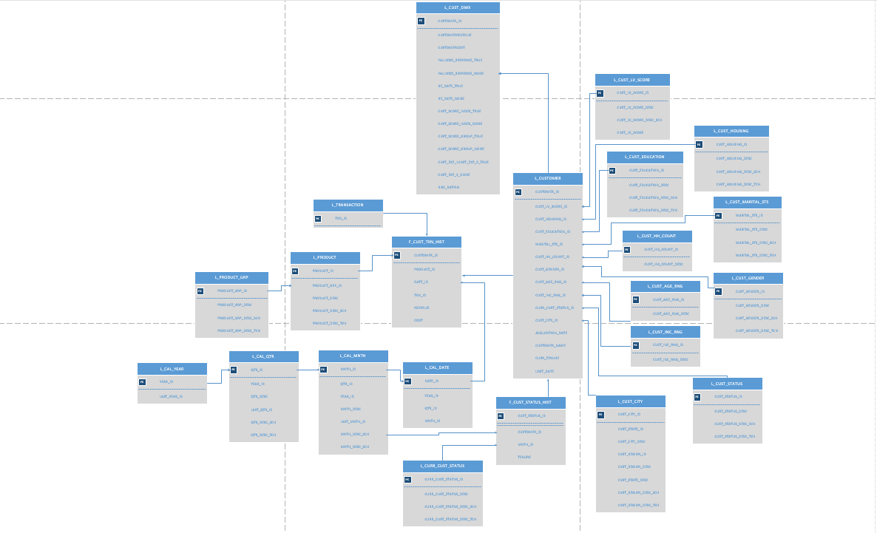
Data model Graphical representation

Slide 3
Data Dictionary

Slide 4
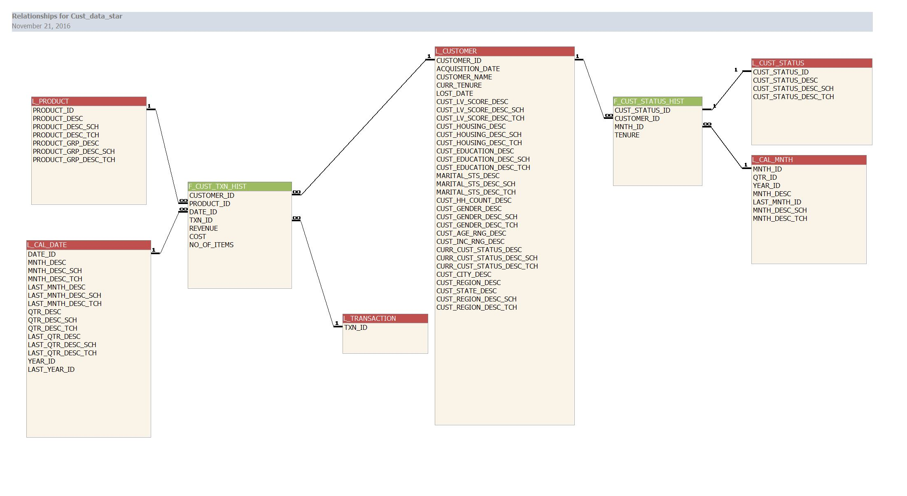
Conversion of snowflake to star

Slide 5
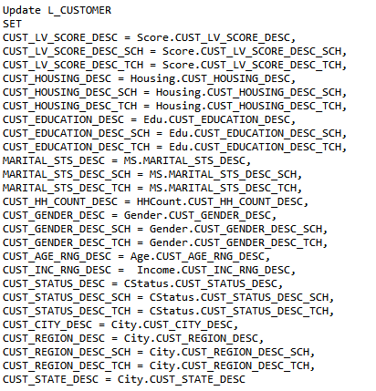
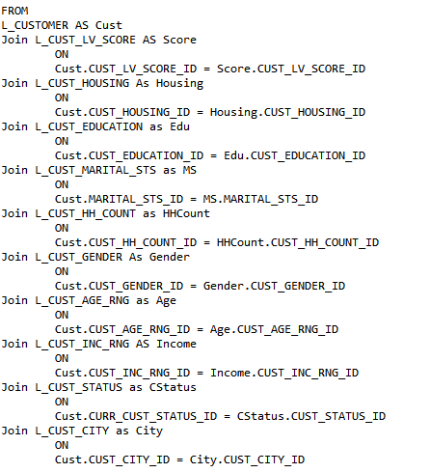
Data population - Customer

Slide 6

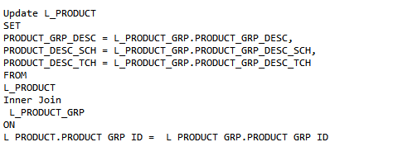
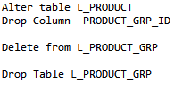
Data population - Product

Slide 7
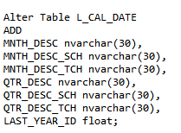
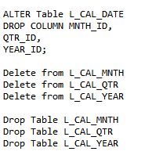
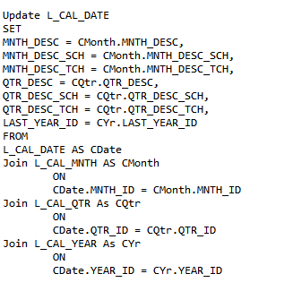
Data population - Date

Slide 8
Tableau dashboard links

Slide 9
Assumption of data Sources

Slide 10
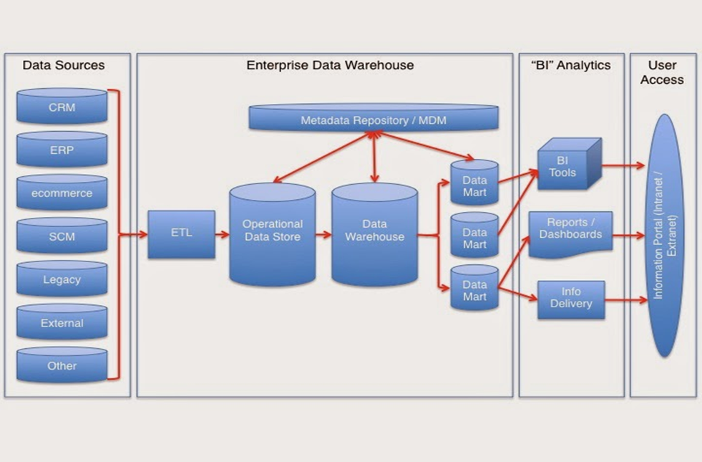
Logical representation of system Architecture
Three Tier Architecture
Bottom Layer – Staging is used to store raw data (Data Sources)
Middle Layer – Integration to integrate data (Enterprise Datawarehouse)
Top Layer – Access Layer Getting data out for the users. (Query and Reporting Tools- Tableau)

Slide 11
Monthly historical analysis

Slide 12
Proposed dashboard

